Slide 1
Azure Data Lake: Tools of the Trade
Presented by Patrick Chorley

Slide 2
What is a data lake?
"A data lake is a storage repository that holds a vast amount of raw data in its native format until it is needed. While a hierarchical data warehouse stores data in files or folders, a data lake uses a flat architecture to store data. Each data element in a lake is assigned a unique identifier and tagged with a set of extended metadata tags. When a business question arises, the data lake can be queried for relevant data, and that smaller set of data can then be analyzed to help answer the question." - TechTarget.com

Slide 3
What is a data WAREHOUSE?
"A data warehouse is a subject-oriented, integrated, time-variant and non-volatile collection of data in support of management's decision making process.
Subject-Oriented
Integrated
Time-Variant
Non-volatile" - Bill Inmon

Slide 4
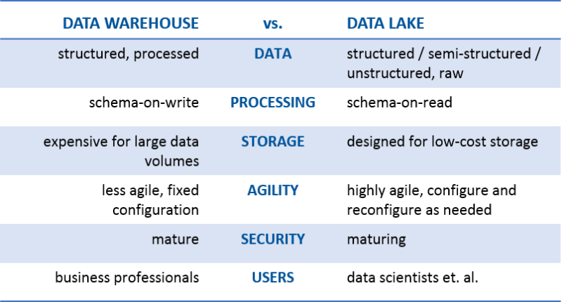
How does it compare to a data warehouse?

Slide 5
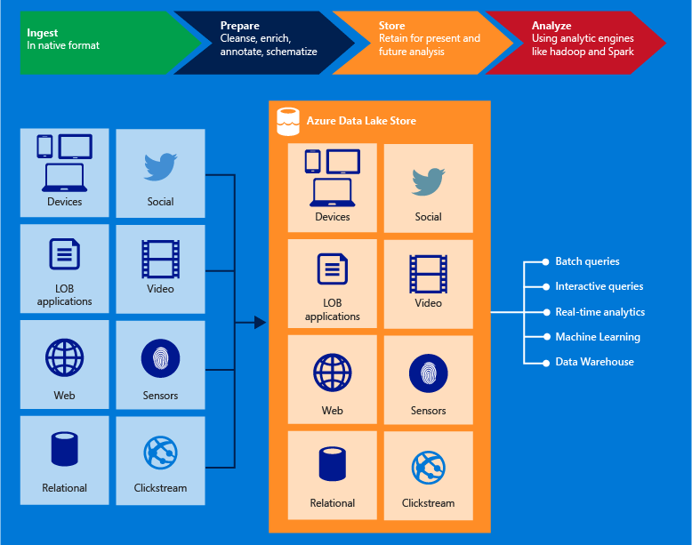
What is Azure Data Lake
Azure Data Lake Store
Hadoop Distributed File System
Big data store

Slide 6
What is Azure Data Lake
Azure Data Lake Analytics
Runs analysis jobs primarily on big data sources
Has automatic scaling
Uses U-SQL
A combination of .NET and SQL
We'll talk more about it later
Can also be used to query Azure Blob storage and Azure SQL DB and DW

Slide 7
Cost
Azure Data Lake (4 TB)
Pay-As-You-Go: $156 per month
Monthly Commitment: $140 per month
Hadoop (4 TB)
Server and storage: $4000
I'm not saying one is better than another.

Slide 8
Sources
Files (raw, structed, semi-structured, and non-structured)
Blobs
Databases
Streaming
Event Hubs
Stream Analytics
HDInsight

Slide 9
ETL/ELT Overview
Azure Data Factory V1
U-SQL
Azure Data Factory V2
SSIS
PolyBase
Hadoop technologies (Hive, Pig, MapReduce, HadoopStreaming, and Spark) <--Run on HDInsight

Slide 10
ETL/ELT
Azure Data Factory V1
Simple
JSON
Not glamourous
The engine that runs ETL
Transformation handled outside of Data Factory with DF acting as a wrapper
Built in auditing
There are limitations
Cannot process Analysis Services models currently

Slide 11
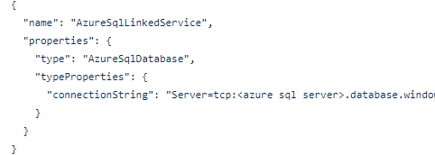
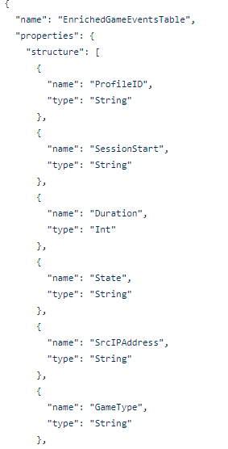
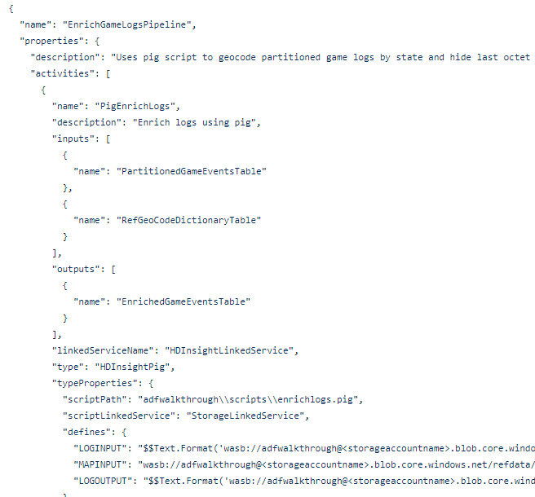
ETL/ELT
Azure Data Factory V1 Sample

Slide 12
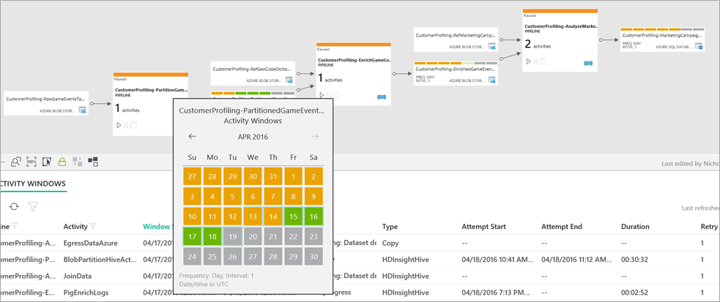
ETL/ELT
Azure Data Factory V1 Scheduler

Slide 13
ETL/ELT
U-SQL
Used for transformations
A combination of .NET and SQL
Very easy to learn
Data Factory V1 can execute U-SQL scripts
Extractors
Txt
Csv
Tsv
There are extensions for Python and R

Slide 14
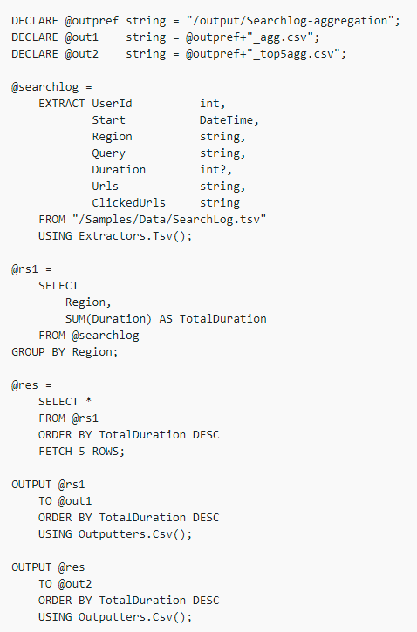
ETL/ELT
U-SQL Example
Use variables from Data Factory
Create table
Aggregate data
Fetch must accompany ORDER BY
Output transformed data

Slide 15
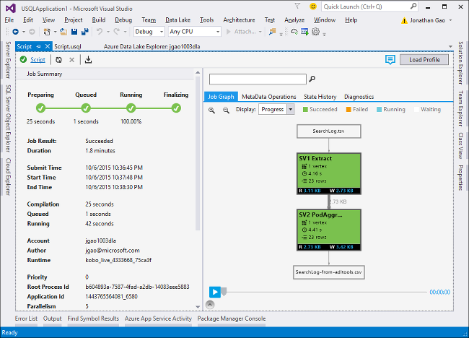
ETL/ELT
U-SQL Execution
Which stages read more data
Which stages are taking the longest
Which stages were successful
Diagnostics
How to improve performance
Model if more contains will make the job faster

Slide 16
ETL/ELT
SSIS
Connection Managers
Azure Storage Connection Manager
Azure Subscription Connection Manager
Azure Data Lake Store Connection Manager
Azure Resource Manager Connection Manager
Azure HDInsight Connection Manager
Tasks
Azure Blob Upload Task
Azure Blob Download Task
Azure HDInsight Hive Task
Azure HDInsight Pig Task
Azure HDInsight Create Cluster Task
Azure HDInsight Delete Cluster Task
Azure SQL DW Upload Task
Azure Data Lake Store File System Task
Data Flow Components
Azure Blob Source
Azure Blob Destination
Azure Data Lake Store Source
Azure Data Lake Store Destination
Azure Blob & ADLS File Enumerator

Slide 17
ETL/ELT
Azure Data Factory V2
Execute SSIS task
Control Flow
Like in SSIS
Activity dependencies
ForEach and DoUntil
GetMetaData activity
Validate or retrieve metadata
On-Demand Processing
Incremental load
Scheduling
Look-up Activity

Slide 18
ETL/ELT
PolyBase
Querying external data
Importing data
Exporting Data

Slide 19
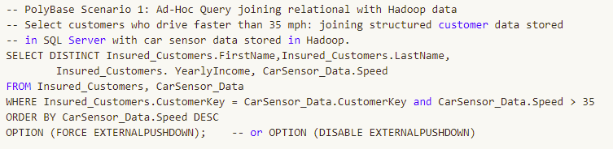
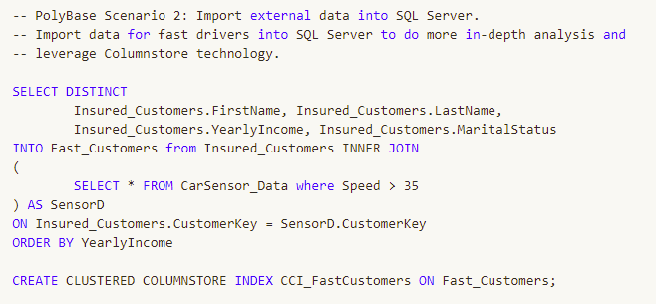
ETL/ELT
PolyBase Example

Slide 20
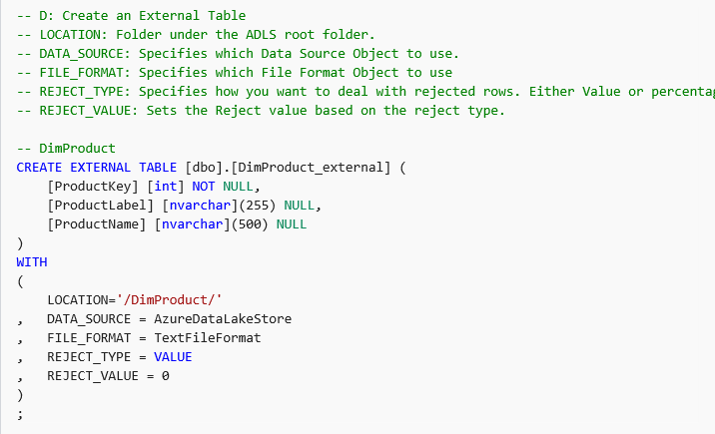
ETL/ELT
PolyBase Example

Slide 21
Destinations
Data Lake Store/Data Lake Analytics
Could be used for staging and refinement
Would be a cheap way to refine data
Processing this way is currently offers less flexibility but the addition of SSIS can improve that
Allows access to a different set of users than SQL wouldl

Slide 22
Destinations
Azure SQL Database
In memory OLTP
Always encrypted
Good for applications
Allows for more queries
Azure Data Warehouse
PolyBase
Pause and Resume
Good for Data Warehousing
Go figure
You can use either or both

Slide 23
Destinations
Azure Analysis Services
Cannot connect to Azure Data Lake
As of September you can connect to Azure Data Lake
Can connect to Azure SQL or Azure Data Warehouse
Missing some features
Data Factory currently lacks the ability to process an tabular model
You can deploy existing models

Slide 24
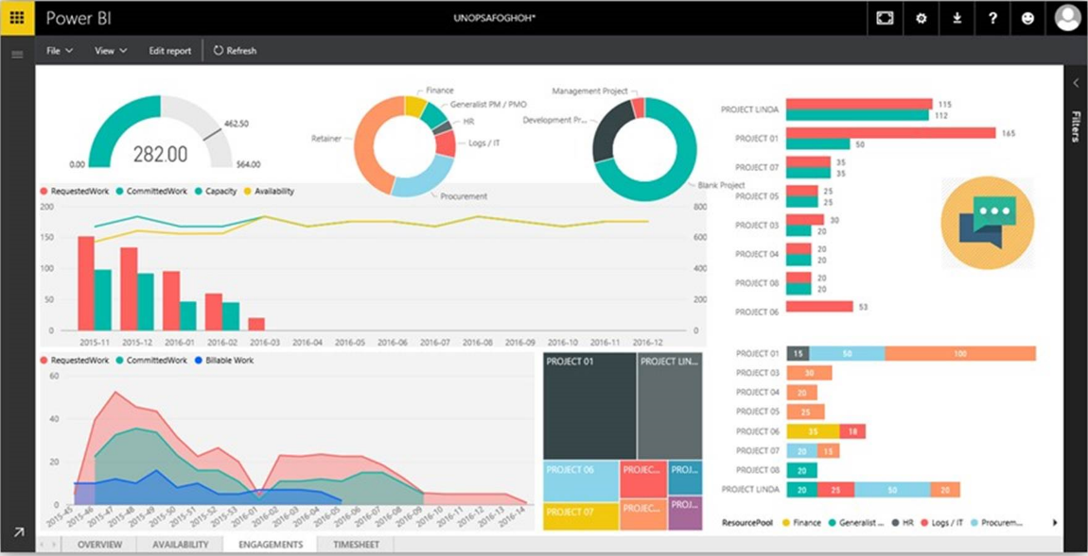
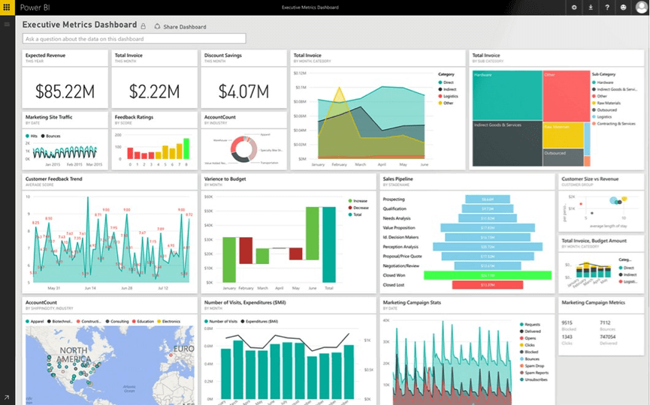
Destinations
Power BI
Dashboarding and collaboration tool

Slide 25
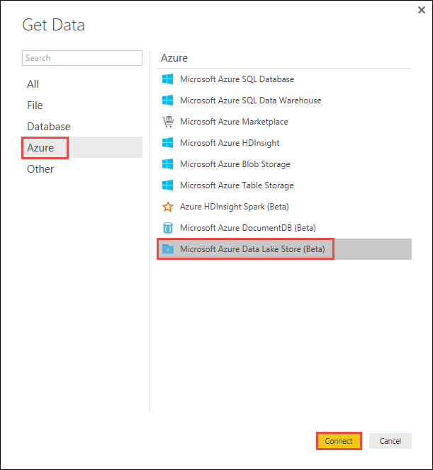
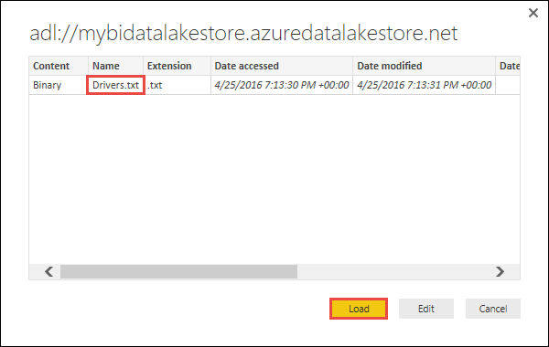
Destinations
Power BI
Can connect to Azure Data Lake store
Agile!
Risky!

Slide 26
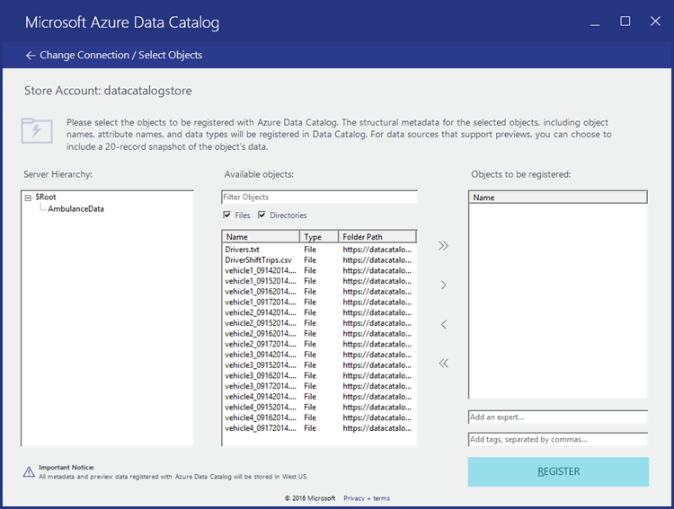
Destinations
Azure Data Catalog
Manages datasets
Helps users:
Discover
Understand
Consume

Slide 27
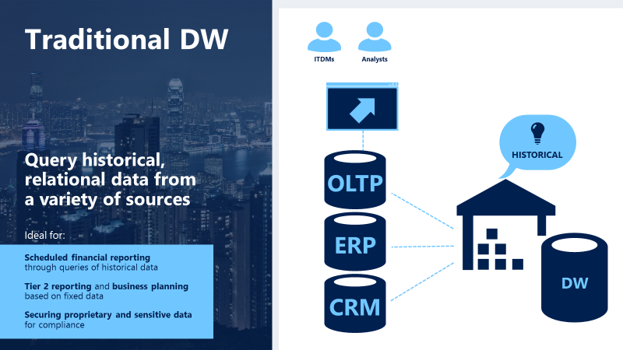
Traditional BI

Slide 28
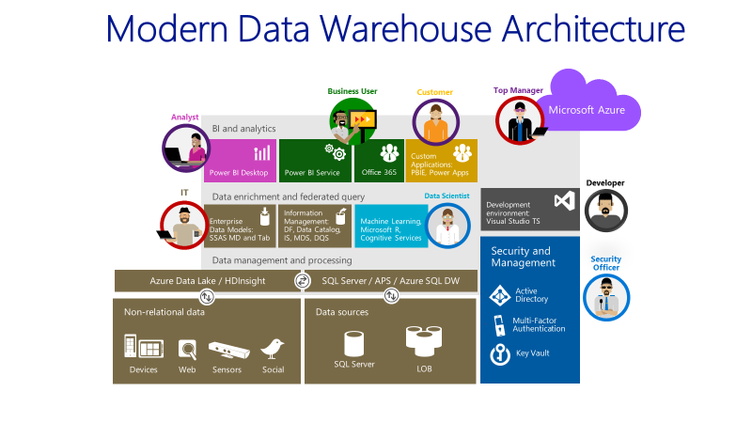
MODERN BI

Slide 29
Conclusion
Azure Data Lake offers new capabilities and options to customers
With growing data we need to reevaluate our approach
With more tools available we need to consider what is best for the task at hand and what are the limitations

